Slide 1
Secure Data Hiding in Images Using Steganography
CAPSTONE PROJECT
Presented By:
Student Name : Rupesh Gopal SIngh
College Name & Department : Ramniranjan Jhunjhunwala College

Slide 2
OUTLINE
Problem Statement
Technology used
Wow factor
End users
Result
Conclusion
Git-hub Link
Future scope

Slide 3
Problem Statement
With the increasing exchange of sensitive data over the internet, traditional encryption techniques are often not enough to ensure secure communication. Steganography provides an additional layer of security by embedding data into images, making it invisible to unauthorized users. This project aims to develop a secure and efficient method to hide and extract data within images using steganographic techniques.

Slide 4
Technology used
Programming Language: Python
Libraries: OpenCV, NumPy, PIL (Pillow), Stegano
Encryption Algorithm: LSB (Least Significant Bit
Steganography Platform: Jupyter Notebook/PyCharm

Slide 5
Wow factors
Uses LSB-based image steganography to securely hide information.
Ensures high data security by making hidden data undetectable to the naked eye.
Can be used for secure communication in various domains like defense and personal privacy.
Efficient encoding and decoding process with minimal image distortion

Slide 6
End users
Cybersecurity Enthusiasts
Government and Defense Organizations
Journalists and Whistleblowers
Individuals Seeking Secure Communication

Slide 7
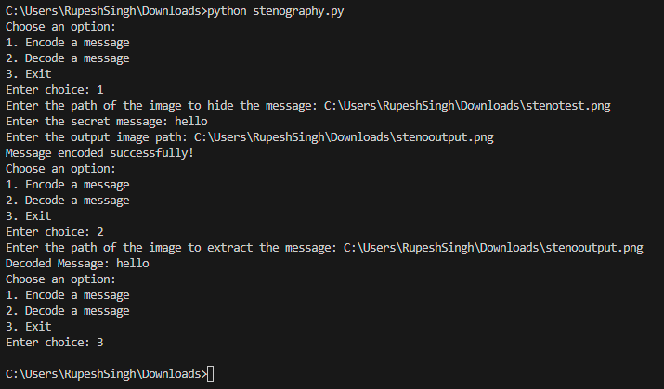
Results

Slide 8
Conclusion
This project successfully demonstrates how steganography can be used to securely hide data within images. By using the Least Significant Bit (LSB) method, sensitive information can be transmitted safely without attracting attention. This technique enhances privacy and provides an additional layer of security in data communication.

Slide 9
GitHub Link
https://github.com/rupeshgs006/aicte_cybersecurity/

Slide 10
Future scope(optional)
Implementing additional encryption layers before embedding data.
Expanding the project to support different types of files like audio and video.
Enhancing the project with AI-based steganography for better security.
Creating a mobile/web application for easy accessibility.

Slide 11
THANK YOU

